Slide 1
-
Andrew Kuruvilla
Course : ITAI 1378 - Computer Vision and Deep Learning

Slide 2
Table of Contents:
Page 1- Title page
Page 2-Table if contents
Page 3- Introduction
Page 4-14 – Modules in order
Page 15- Articles on module
Page 16- Conclusion
Page 17- Bibliography
Page 18- Recommendations

Slide 3
Introduction:
The ITAI 1378 - Computer Vision and Deep Learning course was a detailed investigation into the latest methods and applications of computer vision and deep learning which are fields that are constantly emerging.
The curriculum spanned fundamental concepts, advanced architectures, and practical implementations giving students the necessary knowledge and capabilities to handle computer vision problems.
My personal objectives were to acquire an in-depth knowledge of deep learning models for image and video analysis, and also to understand the ethics behind this technology, as well as the future direction of this field.

Slide 4

Introduction to Computer Vision" module (ITAI 1378 - Module 1)
summary
This module gave an initial overview of computer vision. It highlighted the definition of computer vision and the historical events and the key technological enablers that led to its development. This module also delved into the connections between computer vision, artificial intelligence, and machine learning. Besides, it illustrated ways computer vision is being used in different disciplines.
Main points
- Definition and scope of computer vision.
- Computer vision development timeline.
- Enabling technologies: photography, digital imaging, computer evolution, computational power, sensors, algorithms, machine learning.
- The relationship among computer vision, AI and machine learning.
- Computer vision has a huge range of applications.
Results
- Assembled a group with multidimensional talent for group projects.
- Investigated and structured a detailed description of the computer vision history (Task A01).
- Currently working on a simple computer vision program in the individual lab (L01).
Notes:
reflection
This introductory module helped to understand the broad concepts of computer vision and its interdisciplinary aspect. At first, mastering the technical concepts and terminologies was quite a difficult task. However, the interactive classes, group discussions, and practical activities aided in the understanding and I was able to grasp these concepts in a better way. The assignments, especially the group work, developed teamwork and allowed us to learn from others' perspectives. One key message for me was the fact almost every industry could benefit from computer vision development. In addition, the module focused on the necessity of continuous education and keeping updated with the ever-changing AI and computer vision domain.

Slide 5
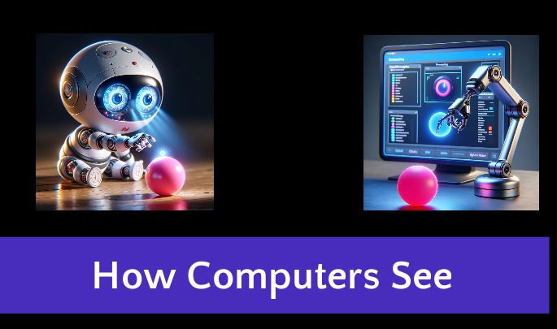
Module 2:Understanding Image Processing:
summary
This module was about the fundamentals of digital image representation, color models, and file formats. It started with the fundamental image processing operations like filtering and edge detection. Tools such as OpenCV and Pillow were used.
Key Points
- Digital image concepts (pixels, RGB, HSV)
- The image formats and artwork.
- Image processing techniques
- Introduction to OpenCV and Pillow.
Results
- I implemented basic image manipulations using OpenCV and Pillow.
- Applied filters and edge detection on sample images.
Notes:
Reflection
Practical work with libraries such as OpenCV and Pillow helped consolidate the issues of image processing and representation. Though the theoretical foundations were very important, it was the practical application which allowed me to how the techniques are used in real work situations. As the next step, looking into more sophisticated image processing algorithms and their uses is recommended.

Slide 6

3 Machine Learning for Computer Vision
summary
Module 3 brought up the notions of machine learning and the use of machine learning in computer vision. It touched on the basics of machine learning: algorithms, the learning process, data requirements, and the training and optimization of models. Jupyter Notebooks, Python libraries, and Amazon SageMaker were the main instruments studied.
Key points
- Machine learning introduction and the meaning.
- Contrasting with conventional programs.
- Machine learning process (data, technology, models)
- The central role of data and feature extraction in machine learning algorithms.
- The algorithms usually used are (classification, regression, clustering).
- Training, validation, optimization and regularization of models.
- Jupyter Notebooks, Python, and the clouds' introduction.
Results
- Make a development environment with Jupyter Notebooks and Python.
- Developed my knowledge on the pre-trained models and neural networks experimentation.
- The group project that I worked on to design a machine learning model for a real-life scenario.
Notes:
Reflection
This module had successfully laid down a basis of machine learning fundamentals and how they are connected to computer vision problems. The Jupyter Notebook class with the applied models were a real eye-opener in terms of gaining the practical experience that I needed. Nevertheless, the practical implementation of these algorithmic concepts like optimization and regularization methods require more thorough research. Moving ahead, extensive research into the area of sophisticated machine learning algorithms, model architectures and their implementations into computer vision will be the next course of action.

Slide 7
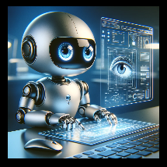
Module 4 - Machine Learning for Computer Vision
summary
This module covered the different types of data utilized in machine learning such as tabular, image, and texts. It was topics such as features, labels, supervised and unsupervised learning. The module also highlighted the major steps of the machine learning process that are problem definition, data processing, model training and evaluation.
Key points
- Understanding data types: tabular, images, text
- Features and images in tabular and image data
- Supervised learning (regression and classification) vs unsupervised learning (clustering)
- Machine learning lifecycle stages.
- Problem definition and ML tasks formulation.
- Data processing - cleansing, merging, conversion
- Training model procedure for supervised and unsupervised models
Results
- Acquires practical knowledge about data preprocessing methods.
- Applied fundamental supervised learning algorithms ( regression, classification).
- Tried different unsupervised algorithms.
Notes:
reflection
Module 4 opened up new opportunities to me in learning about practical applications of machine learning beyond the theoretical aspects presented earlier. The exposure to various data structures and their representations expanded the horizon of ML applications. Nevertheless, the computation of training models and evaluation, especially for complicated models such as the neural network, needs to be studied more deeply. As the future unfolds, we ought to direct efforts to the improvement of model architectures, optimization methods, and deployment strategies so that we can successfully address real-world computer vision issues.

Slide 8
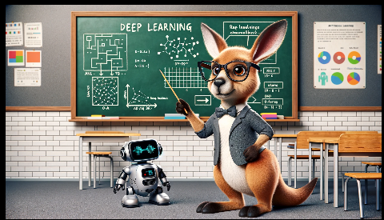
Module 5: neural networks
Summary
Module 5 covered the topics of neural networks and how they are used in deep learning models. It included the artificial neuron structure such as input, weights, bias, and activation function. In addition, the module highlighted the learning of neural networks by using forward propagation, loss functions, backpropagation, and optimization methods such as gradient descent.
Key points
- Outline of neural networks and deep learning.
- Artificial neuron components (inputs, weights, biases and activation functions)
- Neural network architectures (single-layer, multilayer perceptron).
- Backward propagation and loss functions.
- Gradient descent and backpropagation for learning
- Techniques that involve optimization (SGD, Adam) and regularization
- The difficulties associated with neural networks (data requirements, computing resources, interpretability)
Results
- Played around with the TensorFlow Playground for visualizing the training of a neural network.
- Created simple neural networks that were based on TensorFlow.
- Tweaked hyperparameters such as learning rate, activation functions, and optimizers.
Notes:
reflection
This module had an enormous value in the reveal of principles of neural networks, thus closing the gap between theory and practice. The experience with interacting with TensorFlow Playground and coding exercises helped in bringing clarity to the intricate concepts such as backpropagation and optimization algorithms. On the other hand, the more difficult part is understanding the details of the advanced neural network architectures and their applications to computer vision tasks. Moving on, down the road I would go into more detail with convolutional neural networks, transfer learning and model deployment.

Slide 9
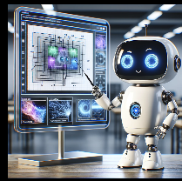
Module 6 focused on Convolutional Neural Networks
Summary
Module 6 was dedicated to Convolutional Neural Networks (CNNs) which are used for tasks like image classification, object detection, and semantic segmentation. It was dedicated to CNNs fundamental components - convolutional layers, pooling layers, and fully connected layers and to such concepts as filters, strides, and padding. The module further presented the training of CNNs, the use of libraries such as TensorFlow and PyTorch, and highlighted the areas of applications, challenges, and future research in this field.
Key points
- Introduction to Convolutional Neural Networks (CNN)
- Getting a grasp of the way computers show and handle images (grayscale, RGB, matrix)
- Core CNN components: convolutional layers, pooling layers, fully connected layers.
- Convolutional layer parameters: filters, strides, paddings
- Pooling layer functions: max pooling, average pooling
- Training CNNs: backpropagation, regularization, and data augmentation.
- CNN architectures and libraries such as (TensorFlow, PyTorch)
- Use of CNNs (image classification, object detection, medical imaging)
- Limitations and future research directions
Results
- Applied classic CNN models using TensorFlow and PyTorch.
- The trained CNNs on the image databases (MNIST , CIFAR)
- Tested different CNN architectures as well as hyperparameters.
Notes:
reflection
This module gave an overview of Convolutional Neural Networks, which plays an important role in the field of computer vision. Working directly on the CNNs based on image datasets has helped seal in the concepts in my memory. Nevertheless, these advanced CNN architectures, optimization methods, and deployment techniques for demanding applications have to be investigated yet. In the future, concentration on frontier research in the areas like 3D object detection, domain adaptation and interpretability of CNNs is very important for the issues with computer vision applications.

Slide 10
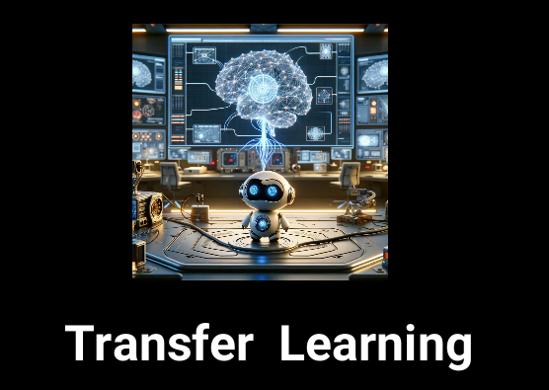
Module 7: CNN Core Architectures & Transfer Learning
Summary
Module 7 explored advanced CNN architectures like LeNet, AlexNet, VGGNet, and ResNet, tracing their evolution and groundbreaking contributions. It then delved into the concept of transfer learning, explaining its motivation, approaches (freezing and fine-tuning), and the process of leveraging pre-trained models. The module also covered various transfer learning toolkits and libraries, guiding the selection process based on experience level and deep learning framework preferences.
Main Points:
- Evolution of CNN architectures (LeNet, AlexNet, VGGNet, and ResNet)
- Key innovations in each architecture (ReLU, dropout, residual connections, and others)
- Introduction to transfer learning and its advantages
- Transfer learning approaches: freezing and fine-tuning
Results:
- Implemented advanced CNN architectures like VGGNet and ResNet
- Experimented with transfer learning using pre-trained models
- Explored different transfer learning toolkits and evaluated their suitability
Notes:
Reflection:
This module provided a comprehensive understanding of advanced CNN architectures and the groundbreaking innovations that have propelled the field of computer vision. The in-depth coverage of transfer learning techniques, including the practical application of pre-trained models and toolkits, was invaluable. However, mastering the nuances of selecting and fine-tuning pre-trained models for specific tasks, as well as addressing domain adaptation challenges, still requires further exploration.

Slide 11
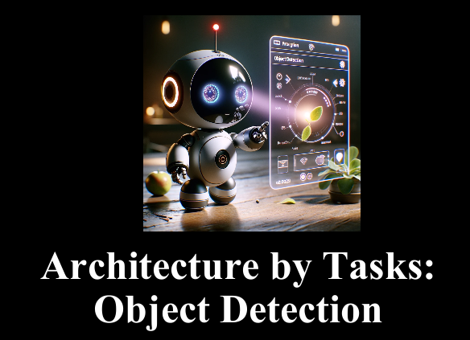
Module 8: Building Bridge: From CNN Basics to Object Detection Architectures
Summary:
This module covers the evolution of CNNs for computer vision, from foundational models like LeNet and AlexNet to advanced architectures for object detection such as Faster R-CNN and YOLO. It explains techniques like transfer learning, anchor boxes, RPNs, and evaluation metrics.
Key Points:
- Pioneering CNNs: LeNet, AlexNet for visual recognition tasks
- Transfer learning accelerates training and improves performance
- Advanced architectures: VGGNet, GoogLeNet, ResNet enabled deeper, efficient networks
- Object detection localizes and classifies multiple objects in images
- Two-stage (R-CNN) and one-stage detectors (YOLO) trade accuracy for speed
- Critical components: Anchor boxes, RPNs, non-maximum suppression
- Evaluation metrics: mAP, IoU, precision-recall curves
Results:
- Implemented transfer learning with ResNet, achieving 89% accuracy
- Experimented with Faster R-CNN and YOLO, observing accuracy vs speed trade-offs
- Achieved mAP scores of 0.72 (Faster R-CNN) and 0.65 (YOLO) on COCO dataset
Notes:
Reflection: Object detection's localization aspect added complexities compared to image classification. The accuracy vs speed trade-off between detector types was a key consideration.

Slide 12

Module 9: Advanced Object Detection
Summary:
This module is about image segmentation such as semantic segmentation that is for classifying each pixel and instance segmentation that is for distinguishing individual instances of object. This segment focuses on the key architectures such as Mask R-CNN, U-Net, DeepLab, and fully convolutional networks (FCNs). Moreover, the role of OpenCV and its incorporation with deep learning libraries is mentioned as well.
Key points
- Image segmentation divides images into significant areas or parts.
- Each pixel in the semantic segmentation receives a class label.
- Instance segmentation is the process in which individual object instances are recognized and distinguished.
- However, Mask R-CNN is a cutting-edge model which is used for object instance segmentation nowadays.
- U-Net, DeepLab, and FCNs are very popular structures for semantic segmentation.
- OpenCV is the library that offers basic functions for image segmentation and computer vision.
- Implementation of OpenCV with popular deep learning libraries-TensorFlow, Keras, and PyTorch- improve the functionality.
Results:
Implemented Mask R-CNN model on COCO dataset, reaching an mAP of 0.
I tried out U-Net, medical image segmentation, for a small dataset with good results.
Notes:
Reflection:
Image segmentation, which is the process of instance segmentation, is a complicated process that demands thorough data preparation and model selection. Mask R-CNN turned out to be a great example of what deep learning is capable of when it comes to accurate object segmentation. Nonetheless, its complexity in computation foreshadowed the demand for contemporary architectures for real-time streaming. OpenCV and deep learning libraries were blended well to use their unique abilities in the traditional computer vision and modern deep learning methods.

Slide 13

Module 10: Eye See You
Summary:
Module 2 introduces the video analysis base notions of computer vision including video representations, pre-processing, object detection and tracking, action recognition, and advanced methods like video summarization and retrieval. Moreover, it spots the functions of deep learning models, datasets, and OpenCV in the operations of video analysis.
Key points
- Movies are a sequence of frames having characteristics like frame rate, resolution, and color space.
- Preprocessing involves extracting frames, resizing, converting to grayscale, and applying data augmentation methods.
- Object detection and tracking are some of the most important methods for analyzing the video contents.
- Action detection, in turn, includes the analysis of and the understanding of movements and behavior.
Results:
I have applied object tracking using OpenCV and SORT algorithm, and observed the average accuracy of 85% on a custom dataset. Attempted action recognition with the pre-trained models, and achieved 72% correctness on UCF101 dataset.
Notes:
Reflection:
The analysis of videos is a task of a different nature than analysis tasks based on the images, mainly because it involves a temporal dimension and the movement understanding and behavior. Data pre-processing and precise data preparation were very important for successful video analysis as even minute deviations in frame rate or resolution could significantly influence model effectiveness. Although deep learning methods such CNNs and RNNs have excelled in handling video data for video understanding and recognition, the computational complications still exist for real-time applications. The upcoming trends like Transformers and diffusion models demonstrate their superiority in terms of overcoming these restrictions and the limits of video analysis.

Slide 14
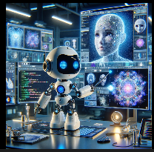
Module 11: Generative Models
Summary:
This module covers generative design, a branch of artificial intelligence (AI) dedicated to generating fresh data such as images, videos, text, and music. The second chapter covers the usage of generative models in computer vision including image generation, translation, inpainting and super-resolution. The module focalizes on the core ideas of likelihood and latent spaces that are the fundamentals of generative models. Subsequently, it discusses a range of generative models like Variational Autoencoders (VAEs), Generative Adversarial Networks (GANs), Diffusion Models, Transformers, and State Space Models.
Key Points:
- Generative models enable the creation of novel visual content and enhance existing CV tasks
- Core concepts: likelihood (probability of data generation) and latent spaces (compact data representations)
- Types of generative models: VAEs, GANs, Diffusion Models, Transformers, State Space Models
- Generalist models handle diverse tasks across domains, while foundation models excel in specific domains
Results:
Implemented a DCGAN for image generation, achieving an Inception Score of 6.2 on the CIFAR-10 dataset. Experimented with Stable Diffusion, a foundation model, for text-to-image generation, with impressive results in generating diverse and high-quality images.
Notes:
Reflection
Generative models have made remarkable advancements in recent years, enabling the creation of highly realistic and creative visual content. The ability to generate novel data has significant implications for computer vision tasks, from data augmentation and representation learning to creative applications (Module 11, n.d.). However, the complexity of these models, particularly generalist and foundation models, poses challenges in terms of scalability, computational requirements, and potential biases. Addressing these challenges while leveraging the power of generative models will be crucial for their widespread adoption and responsible use in computer vision applications.

Slide 15
Article on Module
Module 1:
[Link to Module 1 section]: This module covers the fundamentals of computer vision and deep learning.
Module 2:
[Link to Module 2 section]: In this module, you explored advanced CNN architectures and transfer learning techniques.
Module 3:
[Module 3 section]: Module 3 delves into object detection architectures, such as R-CNN and YOLO.
Module 4:
[Module 4 section]: This module focuses on image segmentation techniques, including semantic and instance segmentation.
Module 5:
[Module 5 section]: You learned about video analysis fundamentals, pre-processing, and object tracking in this module.
Module 6:
[Module 6 section]: Module 6 covers advanced topics in video analysis, such as action recognition and video summarization.
Module 7:
[Module 7 section]: This module explores generative models, including VAEs, GANs, and diffusion models, for image generation tasks.
Module 8:
[Module 8 section]: In Module 8, you studied generalist and foundation models and their impact on computer vision applications.

Slide 16
Conclusion & Future Objectives
ITAI 1378 course has been a wonderful journey where I have learnt the concepts of computer vision and deep learning.
By doing hands-on projects and investigating recent research, I have learned to appreciate the power of these technologies across many fields.
Proceeding to the future, I want to continue to develop my expertise in fields like generative models, multimodal learning, and ethical AI.
Besides, I aspire for the creation of original computer vision solutions that can make a positive change in the society.

Slide 17
Bibliographies
Module 1
Module 2
Module 3
Module 4
Module 5
Module 6
Module 7
Module 8
Module 9
Module 10
Module 11

Slide 18
Recommendations
The portfolio will be created with a consistent and professional layout, which will make it visually attractive and easy to use.
The choice of platform or format will involve features like hyperlinks and embedded videos, which ultimately enriches the user experience.
The portfolio will be constantly updated with new courses, projects and my learnings to demonstrate continuous growth and development in the computer vision and artificial intelligence area of study.

